Slide 1
2048 Game Agent Using Reinforcement Learning
By
Stuti Agarwal (stuti.agarwal@sjsu.edu)
Bharath Gunasekaran (bharath.gunasekaran@sjsu.edu)
Riddhi Jain (riddhi.jain@sjsu.edu)
Tamanna Mehta (tamanna.mehta@sjsu.edu)

Slide 2
Introduction
2048 is a popular web and mobile game developed in 2014.
A single player plays the game on a 4x4 grid.
The player slides the board tiles in one of the four directions to merge the tiles with the same value, intending to create a tile with higher values each time.
A player moves the tiles using the four arrow keys
up,
down,
right and
left keys.

Slide 3
Problem Statement & Motivation
2048 game is time-consuming and take hundreds of moves to reach 2048 or higher value. Currently, there is no strategy to overcome the randomness involved in this game. The use of RL can help find the most efficient moves to achieve the highest score in an optimal manner.
A Reinforcement Learning approach can be beneficial to solve the issue of inherent randomness in this game.

Slide 4
Methodologies
RL Technique | Team Member
TD0 (Temporal Difference) | Riddhi Jain
Sarsa (State Action Reward State Action) | Stuti Agarwal
Q-Learning | Bharath Gunasekaran
DQN | Tamanna Mehta

Slide 5
TD0 (Temporal Difference)
It is a reinforcement learning technique which is a blend of Monte Carlo and Dynamic Programming.
use random sampling to learn from the current environment of the value function.
It is a better technique which adjusts the prediction for the future before the final result is known.
The Gif here shows the TD0 agent playing the game the Score obtained is 2896 and the max value it converges on is 256 for 10 episodes.

Slide 6
TD0 Hyperparameters Initialization
Hyperparameter | Value
Alpha (Learning Rate) | 0.02
Gamma (Discount Factor) | 0.9999
Epsilon (Exploration Rate) | 0.0001
Episodes | 10

Slide 7
Sarsa(State Action Reward State Action)
SARSA is an ON-Policy technique in Reinforcement learning
It uses the action performed by the current policy to learn the Q-Value.
It Updates the Q-table with (S,A,R,S’) samples generated by the current policy. (S’,A’) is the next state and next action in transition samples.
After reaching S’ it will take action A’ and Use Q(S’,A’) to update the Q-Value.
The Gif here shows the SARSA agent playing the game the Score obtained is 5772 and the max value it converges on is 512 for 10 episodes.
Notes:
the update equation for SARSA depends on the current state, current action, reward obtained, next state and next action.The major difference between it and Q-Learning, is that the maximum reward for the next state is not necessarily used for updating the Q-values. Instead, a new action, and therefore reward, is selected using the same policy that determined the original action.

Slide 8
SARSA Hyperparameters Initialization
Hyperparameter | Value
Alpha (Learning Rate) | 0.01
Gamma (Discount Factor) | 0.75
Epsilon (Exploration Rate) | 0.001
Episodes | 10

Slide 9
Q Learning
Q-Learning is an OFF-Policy technique in Reinforcement learning
It uses the greedy approach to learn the Q-Values
we store all the Q-values in a table that we will update at each time step using the Q-Learning iteration
The Gif here shows the Q-learning agent playing the game the Score obtained is 5388 and the max value it converges on is 512 for 10 episodes.

Slide 10
Q-Learning Hyperparameters Initialization
Hyperparameter | Value
Alpha (Learning Rate) | 0.025
Gamma (Discount Factor) | 0.9999
Epsilon (Exploration Rate) | 0.0001
Episodes | 10

Slide 11
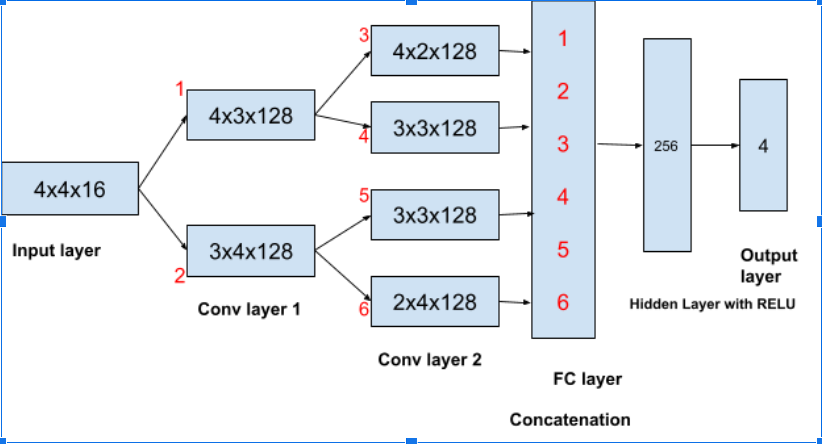
DQN
Combination of Deep Neural Network and Q learning.
Agent’s Brain-Deep Neural Network consist of Convolutional Layers and FC Layers.
Replaces regular Q table with a neural network.
Uses a loss function rather than Q-Learning equation where loss is MSE.
Uses Predicted Q value, target Q value and observed reward to compute the loss to train the network
Max value on board is 256 and Highest score is 2400 for number of episodes-10
Figure1: Network Architecture
Notes:
where in q learning agent brain is q table, dnn is brain for agent in DQN

Slide 12
DQN Hyper Parameters Setting
Hyperparameter | Value
Epsilon (for Greedy approach) | 0.9
Gamma for Q Learning | 0.9
Memory capacity | 5000
Learning Rate | .0005
Batch size | 512
Optimizer | RMS prop
Loss Function | MSE (mean(square(Q(st,at) - (r + gamma x max(Q(st+1,a)))))

Slide 13
Code Walk Through

Slide 14
Conclusion
Due to lack of computing resources, currently models are able to converge with max value of 512 for number of episode=10. The model needs to be trained with more no of episodes to achieve a value of 2048 on a tile/matrix cell.
RL Technique | Max value in board | Total Score of board
Q-Learning | 512 | 5388
SARSA | 512 | 5772
TD0 | 256 | 2896
DQN | 256 | 2400

